Slide 1
Lecture 2 Retrieval Models Part 1
Reference:
James Allan, University of Massachusetts Amherst
Pandu Nayak and Prabhakar Raghavan, Stanford University
Partially modified by Qingcai Chen, HIT Shenzhen
Notes:
Key points:
The differences of exact match and best match models
Query likelihood and document likelihood
Probabilistic estimation by smoothing method for zero frequency problem

Slide 2
What is a retrieval model?
Retrieval models (检索模型) can describe the computational process of IR
e.g. how documents are ranked
Note that how documents or indexes (索引) are stored is implementation
Retrieval models can attempt to describe the human process
e.g. the information need, interaction
Retrieval variables
queries (查询), documents (文档), terms (术语), relevance judgments (相关性判别), users, information needs, …
Retrieval models have an explicit or implicit definition of relevance (相关度)
Notes:
简单的描述一个IR Model，实际上就是： R = M(X)，其中R是输出的文档排序列表，而X则是所有影响到排序结果的变量的集合。

Slide 3
Models we’ll consider
Boolean (布尔模型) (exact match)
Statistical language models (统计语言模型)
Vector space(向量空间）
Latent Semantic Indexing （潜层语义分析）
Inference network
Classic probabilistic approaches（经典概率模型）
Other models exist
Topological
Generalized vector space
Logic-based
in this lecture

Slide 4
Exact vs. Best Match
Exact-match (精确匹配)
(例: “哈工大” ≠“哈尔滨工业大学”, “哈工程” ≠ “哈尔滨工业大学”)
query specifies precise retrieval criteria
every document either matches or fails to match query
result is a set of documents
Unordered in pure exact match
Best-match (最佳匹配)
(例: “哈工大” ≈”哈尔滨工业大学”，相似度80%, “哈工程” ≈”哈尔滨工业大学”，相似度50%)
Query describes good or “best” matching document
Every document matches query to some degree
Result is ranked list of documents
Popular approaches often provide some of each
E.g., some type of ranking of result set
E.g., best-match query language that incorporates exact-match operators

Slide 5
(Unranked) Boolean retrieval
Boolean model
is most common exact-match model
queries are logic expressions with document features as operands
In pure Boolean model, retrieved documents are not ranked
Most implementations provide some sort of ranking
query formulation difficult for novice users (新用户)
Boolean queries (布尔查询)
Used by Boolean model
and in other models (Boolean query ≠ Boolean model)
“Pure” Boolean operators
AND, OR, AND-NOT
Most systems have proximity operators (邻接算子)
Most systems support simple regular expressions (正则表达式) as search terms to match spelling variants
Notes:
An IR model includes not just the representation of queries, but also the representation of documents and the judgments of relevance.
proximity operator is not logical operator.

Slide 6
Unstructured data for Boolean retrieval
Sec. 1.1
Example:
Information needs: Which plays of Shakespeare contain the words Brutus AND Caesar but NOT Calpurnia?
注:Brutus布鲁图 (85-42B.C.,罗马政治家,暗杀恺撒者之一)
Calpurnia 是Julius Caesar的第三任，也是最后一位妻子
One could grep (a command in Linux system) all of Shakespeare’s plays for Brutus and Caesar, then strip out lines containing Calpurnia?
Why is that not the answer?
Slow (for large corpora)
NOT Calpurnia is non-trivial
Other operations (e.g., find the word Romans near countrymen) not feasible
What’s the solution for such problem?
6
Notes:
Grep is line-oriented; IR is document oriented.
6

Slide 7
Document Representation: Term-document incidence
Sec. 1.1
1 if play contains word, 0 otherwise
Brutus AND Caesar BUT NOT Calpurnia

Slide 8
Incidence vectors（关联向量）
Sec. 1.1
So we have a 0/1 vector for each term.
To answer query: take the vectors for Brutus, Caesar and Calpurnia (complemented) ➔ bitwise AND.

Slide 9
Proximity operators
Proximity operators
Phrases - “two fish”
Same sentence “tiger /s photo”
To force order to be honored, “tiger +s photo”
Same paragraph - “southchina tiger” /p “photo”
Similarly, +p forces order
Word proximity “southchina /5 tiger” or “southchina +5 tiger”
Notes:
Proximity operators are strictly not boolean operators.

Slide 10
Features to Note about Queries
Queries are developed incrementally
Change query until reasonable number of documents retrieved
“language models”
“language models” /s statistical
“language models” /s stat!
(“language models” /s stat!) % toolkit
(“language models” /s stat!) % (toolkit HMM)
implicit relevance feedback
Queries are complex
proximity operators used very frequently
implicit OR used for synonyms
NOT (%) is rare
Queries are long (av. 9-10 words)
not typical Internet queries (1-2 words)

Slide 11
Boolean query languages still used
Many users prefer Boolean
Especially professional searchers
“Control”
Understandability
For some queries or collections, Boolean often works better (e.g., using AND on the Web)
Boolean and free text find different documents
Need retrieval models that support both
“Extended Boolean”
vector space
Probabilistic inference network
Need interfaces that provide good cognitive models (认知模型) for ranking (排序)

Slide 12
Models we’ll consider
Boolean (exact match)
Statistical language models

Slide 13
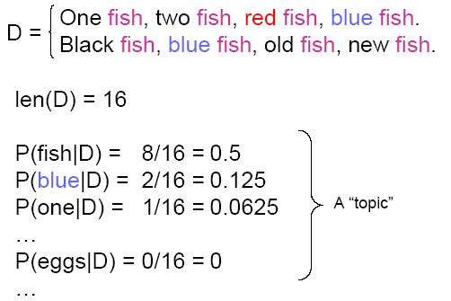
Example: Small document
So we know that document D is more likely to talk about “fish” rather than “egg”!
Notes:
Here we are talking about the representation of document.

Slide 14
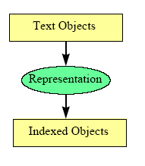
Statistical language model: basic idea
Queries are used to describe the topic of user’s needs.
Document comes from a topic
Topic (unseen) describes how words appear in documents on the topic
Use document to guess what the topic looks like
Words common in document are common in topic
Words not in document much less likely
Assign probability to words based on document
P(w|Topic) ≈ P(w|D) = tf(w,D) / len(D)
Index estimated topics
Notes:
Representation of topic: with topic to approximate the topic.
If a document is come from a topic, then how a topic affects the content of a document?
精确描述一个Topic是很困难的， 比如要精确描述“新生入学”这个事件，该如何描述呢？我们通常只能用一些关键词（或者叫索引词）来大概得勾勒出这个topic的样子，比如用：报道、学费、录取通知书等等词汇来描述

Slide 15


What is a Language Model?
Probability distribution over strings of text
how likely is a given string (observation) in a given “language”
for example, consider probability for the following four strings
… depends on what “language” we are modeling
In English: p1 > p2 > p3 > p4
In most of IR, assume that p1 == p2
for some applications we will want p3 to be highly probable, when?
Notes:
The basic conception of “language model”.
Since we know the representation of a topic, by using the distribution of words in the document coming from the topic, then we can define the language model. In fact, we can assume that a language contains 1 to N topics, here N could be very large.
The example shows that how the probabilities of string sets define the language.

Slide 16


A quick review of probabilistic
Independence
If events w1 and w2 are independent then
P(w1 AND w2) = P(w1) * P(w2)
Bayes’ rule
Notes:
How do we get the Bayes’ Rule?

Slide 17
Language Modeling Notation
Convenient to make explicit what we are modeling:
M … “language” we are trying to model
s … observation (string of tokens from some vocabulary)
P(s|M) … probability of observing “s” in language M
M can be thought of as a “source” or a generator
a mechanism that can spit out strings that are legal in the language
E.g. “人活着就要吃东西” is a legal sentence in Chinese,
But “活着人东西吃” is not (generally) a sentence in Chinese (not include some novels or on Internet)
P(s|M) … probability of getting “s” during random sampling from M
Notes:
On internet, even “3x” is a sentence.
Language can be any type of string sets here rather than just real language like Chinese and English.

Slide 18
Language Modeling for IR
Every document in a collection defines a “language”
consider all possible sentences (strings) that author could have written down when creating some given document
some are perhaps more likely to occur than others
subject to topic, writing style, language …
P(s|M_{D}) … probability that author would write down string “s”
think of writing a billion variations of a document and counting how many time we get “s”
Now suppose “Q” is the user’s query
what is the probability that author would write down “Q” ? *
Rank documents D in the collection by P(Q|M_{D}) [1]
probability of observing “Q” during random sampling from the language model of document D
Notes:
把每种语言的规模缩小为一个话题（对应着语料库中的一个文档）；
这个话题就决定了任意一个字符串在这个话题所对应的语言模型中出现的概率：比如，在一个描述信息检索发展历史的文档中，“Washington”出现的概率就会远远小于“Robertson”.
理论上：我们要想知道一个文本串出现在一个文档（所定以的语言）中的概率，我们需要让大量作者针对同一个话题写出无穷无尽的文档，然后才能统计出来字符串的概率，显然，这不现实；
可是，如果只有一个文档，完全相同的一句话很难出现第二次？那统计还有意义么？什么情况下有意义？
【*】为什么我们不直接说“一个给定文档中查询Q出现的概率”，即使我们很多时候是这样计算的？

Slide 19
Major issues in applying LMs
Which kind of language model should we use?
Unigram or higher-order models?
How can we estimate model parameters
Basic models
Translation models
non-parametric models
How can we use the model for ranking?
Query-likelihood
Document-likelihood
Divergence (差异) of query and document models
Notes:
The detail about the estimation of model parameters is the topic of NLP course, not the course WIR.

Slide 20
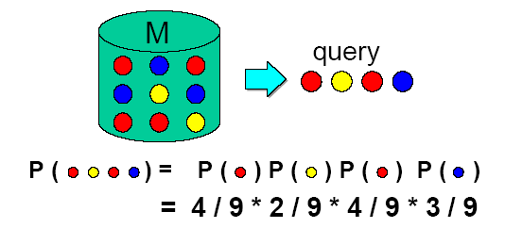
Unigram Language Models
words are “sampled” independently of each other
Metaphor (一个比喻): randomly pulling words from an urn (缸) (with replacement)
joint probability decomposes into a product of each element
estimation of probabilities: simple counting
Notes:
Here introduce more about bi- or tri-gram as a comparison with uni-gram
In addition to the metaphor, using words co-occurrence to illustration higher order n-gram, using the different probabilities of “Computer Software” and “Software Computer” as an example

Slide 21
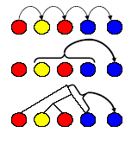
Higher-order Models
Unigram model assumes word independence
cannot capture surface form: P(“brown dog”) == P(“dog brown”)
*Higher-order models
n-gram: condition on preceding words:
cache: condition on a window (cache):
grammar: condition on parse tree
Are they useful?*
no improvements from n-gram, grammar-based models
some research on cache-like models (passages, etc.)
parameter estimation is prohibitively expensive
Notes:
*things may change as the development of techniques and the scale increasing of web docs.

Slide 22


Ranking with Language Models
Standard approach: query-likelihood (查询的似然排序)
estimate a language model M_{D} for every document D in the collection
(assume that we know how to do this)
rank docs by the probability of “generating” the query
Example:
Q = “人民 创造”
D1 = “在 漫长 的 历史 进程 中 中国 人民 辛勤 劳动 不懈 探索 勇于 创造 中国 人民 热爱 和平 ”
P(“人民”|M_{D1})=2/18, P(“创造”|M_{D1})=1/18
P(Q|M_{D1}) = P(“人民”|M_{D1})*P(“创造”|M_{D1}) = 2/18 * 1/18
D2=“中国 人民 勇于 创造”
P(“人民”|M_{D2})=1/4, P(“创造”|M_{D2})=1/4
P(Q|M_{D2}) = P(“人民”|M_{D2})*P(“创造”|M_{D2}) = 1/4 * 1/4
So D2 is more relevant with Q than D1
Notes:
*Because that given a query, the computing of generating probability for each document is totally independent from other documents.

Slide 23
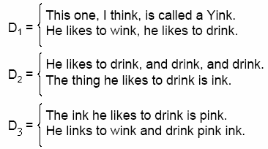





Example (Cont’d)
Notes:
It seems not so simple to compute the probability of a word, students can try to compute the probability of “drink” at first.
End Here.

Slide 24
Ranking with Query Likelihood
Drawbacks:
no notion of relevance in the model: everything is random sampling
user feedback / query expansion not part of the model*
examples of relevant documents cannot help us improve the language model M_{D}
the only option is augmenting the original query Q with extra terms
however, we could make use of sample queries for which D is relevant
does not directly allow weighted or structured queries
Notes:
*Because that given a query, the computing of generating probability for each document is totally independent from other documents.

Slide 25


Ranking: Document-likelihood (文档似然)
Flip(翻转) the direction of the query-likelihood approach
estimate a language model M_{Q} for the query Q
rank docs D by the likelihood of being a random sample from M_{Q}
M_{Q} expected to “predict” a typical relevant document
Problems:
different doc lengths, probabilities not comparable
favors documents that contain frequent (low content) words
consider “ideal” (highest-ranked) document for a given query*:
Notes:
Show example to illustrate the document length problem.
[*]Had been used by traditional SEO (Search Engine Optimization) method.

Slide 26
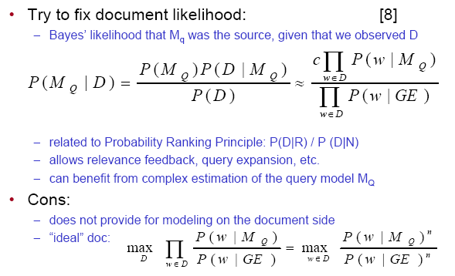
Ranking: Likelihood Ratio
Notes:
Here the Mq defined the language model of all relevant documents, while most of the documents in a huge collection are not relevant, so we can use the full collection set to estimate the probability of document D generated by non-relevant documents.
GE—General English language model, since it is applicable for any language, it can be treated as a symbol representing any general langauge model (not just English)

Slide 27
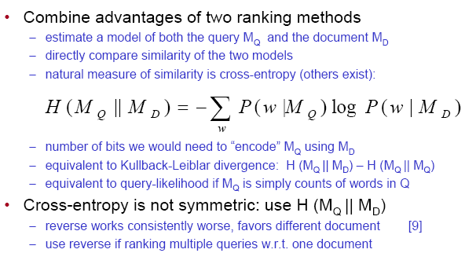
Ranking by Model Comparison

Slide 28
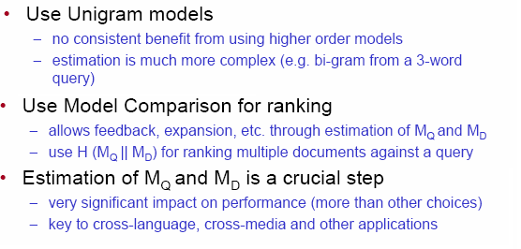
Summary of LM choices

Slide 29
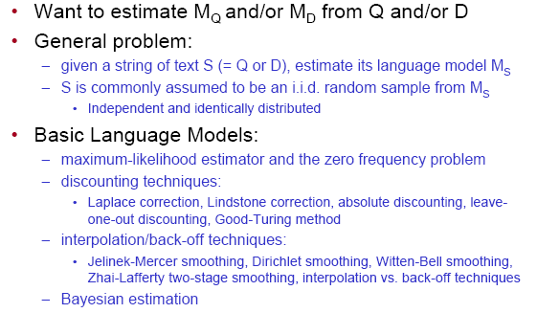
Estimation

Slide 30
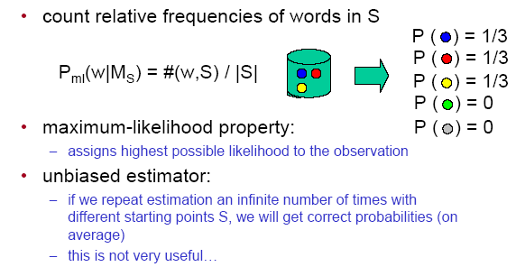
Maximum-likelihood

Slide 31
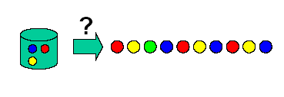
The Zero-frequency Problem
Suppose some event not in our observation S
Model will assign zero probability to that event
And to any set of events involving the unseen event
Happens very frequently with language
It is incorrect to infer zero probabilities
especially when creating a model from short samples

Slide 32
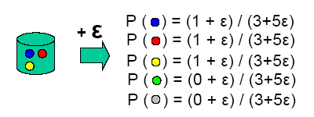
Discounting Methods (折扣法)[6]
Laplace correction:
add 1 to every count, normalize
problematic for large vocabularies
Lindstone correction:
add a small constant ε to every count, re-normalize
Absolute Discounting
subtract a constant ε, re-distribute the probability mass

Slide 33
Basic Models: Summary
Goal: estimate a model M from a sample text S
Use maximum-likelihood estimator
count the number of times each word occurs in S, divide by length
Smoothing to avoid zero frequencies
discounting methods: add or subtract a constant, redistribute mass
better: interpolate with background probability of a word
smoothing has a role similar to IDF in classical models
Smoothing parameters is very important
Dirichlet works well for short queries (need to tune the parameter)
Jelinek-Mercer works well for longer queries (also needs tuning)
Lots of other ideas being worked on
Notes:
Should review the concept “Model”, here a model could be unigram, bi-gram etc., it also could be the probability estimation model, e.g. Unigram + Laplace correction.

Slide 34
Homework 02
Using the Laplace correction, Lindstone correction ( let ε = 0.001) and Absolute Discounting ( let ε = 0.001) smoothing method to recount the probability of above queries on D1, D2 and D3 respectively.
Notes:
It seems not so simple to compute the probability of a word, students can try to compute the probability of “drink” at first.
End Here.

Slide 35

Homework 02
2. While use cross-entropy for document retrieval, why should we use rather than H(M_{D}||M_{Q})?
3. Given a document set, construct the uni-gram model for each document, and then use a table to list the top 10 words according to their probabilities. Their probabilities should also been listed in the table. Each column is corresponding to one document and is named by the document file name. （不做）

Slide 36
Back Up (Self-study)

Slide 37
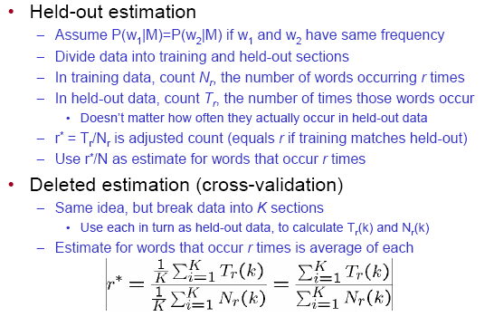
*Discounting methods (cont.)
Notes:
Here for held-out, the instance (or sample) number of training and held-out is the same, say N.

Slide 38
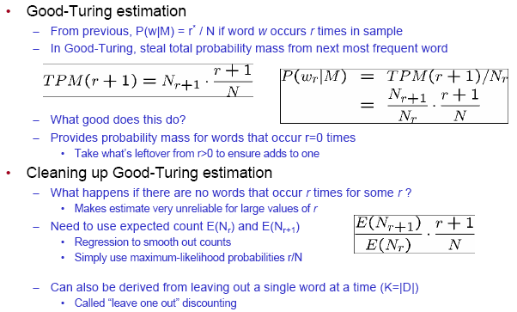
Discounting Methods (cont.)

Slide 39
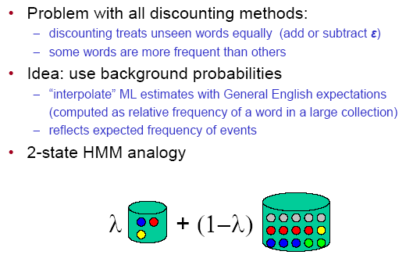
Interpolation Methods [6,7]

Slide 40
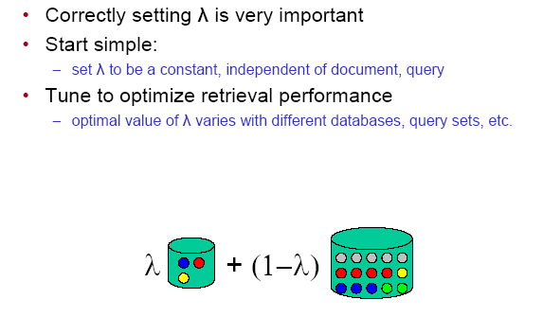
“Jelinek-Mercer” Smoothing

Slide 41
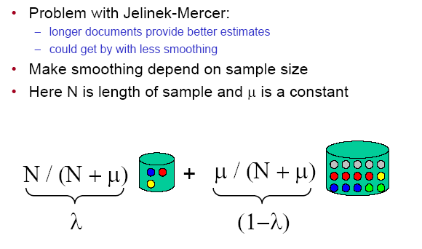
“Dirichlet” Smoothing

Slide 42
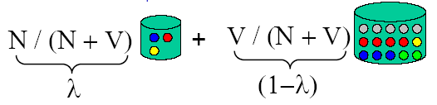
“Witten-Bell” Smoothing
A step further:
condition smoothing on “redundancy” of the example
long, redundant example requires little smoothing
short, sparse example requires a lot of smoothing
Derived by considering the proportion of new events as we walk through example
N is total number of events
V is number of unique events

Slide 43
Interpolation vs. back-off
Two possible approaches to smoothing
Interpolation:
Adjust probabilities for all events, both seen and unseen
Back-off:
Adjust probabilities only for unseen events
Leave non-zero probabilities as they are
Rescale everything to sum to one:
rescales “seen” probabilities by a constant
Interpolation tends to work better
And has a cleaner probabilistic interpretation (HMM, mixture)

Slide 44
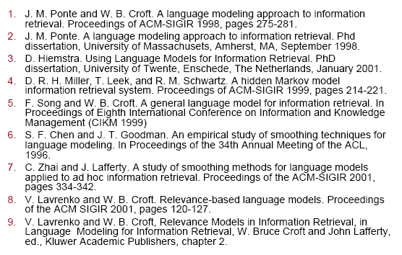
References for language modeling

